Slide 1

LessCSS
(More or less)
Presented by:
Ian Chen-Adamczyk
Saqif Abedin

Slide 2
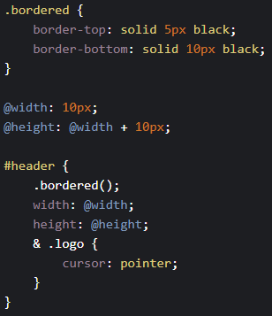
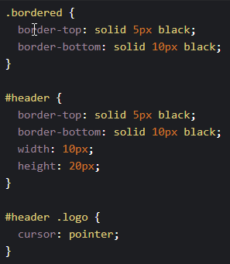
What is Less?
Leaner Style Sheets
“It's CSS, with just a little more.”
Influenced by SASS
Sass was later inspired by Less to create SCSS
A CSS preprocessor extends/adds features for your CSS code
Allows developers to build modular, scalable, and more manageable CSS styles.
Less code looks like this, and needs to be compiled into CSS code
Valid CSS is valid Less code
Compiles into

Slide 3
A Brief History
Less was created in 2009 by Alexis Sellier, otherwise known as @cloudhead
In 2012, Alexis handed over development and management to a group of contributors who now fix and extend the language
It was originally created in Ruby and would eventually be replaced by Javascript
Open Source
Docs Repo: https://github.com/less/less-docs
Less Repo: https://github.com/less/less.js

Slide 4
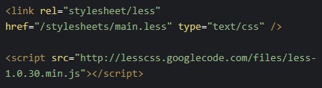
How to use Less?
Method 1: Pre-compiling
Install Less
Install node.js
Download from the website
Linux CLI: sudo apt install nodejs
With node.js, npm install less -g
Compile the Less code in the CLI with this command: lessc source.less destination.css
Use the compiled CSS in your HTML
Method 2: Less.js
Include your .less stylesheet as it is
Include less.js (from a CDN or from the static folder on your server)
client-side variant does not generate output. It compiles the code on each browser reload.
Convenient to get started, not recommended for production
(Basically, just this code in the <head>)

Slide 5
GUIs for Less
Cross Platform (Windows, MacOS, Linux)
Crunch 2!
editor with integrated compiler, good for large projects
Koala
Allows compiling for Less, Sass and coffeescript
Windows Specific
WinLess
More features and supports command line arguments
MacOS Specific
CodeKit
LiveReload
Edits and image changes apply live
Linux Specific
Plessc
Online Less Compilers and Web IDE’s that support Less compiling are also available
Note: there are numerous plugins for existing code editors for Less support
http://lesscss.org/tools/#editors-and-plugins

Slide 6
Features

Slide 7
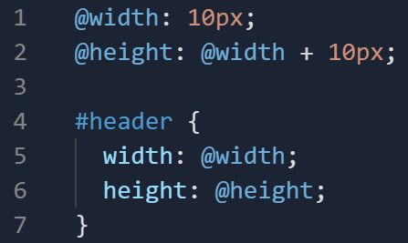
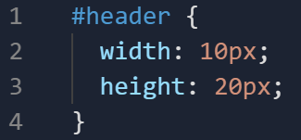
Variables
Prevents repetitiveness when assigning values in declaration blocks
Less
Output (CSS)

Slide 8
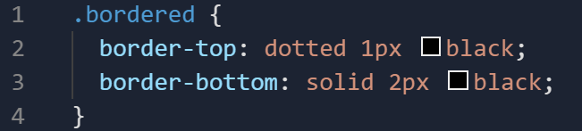
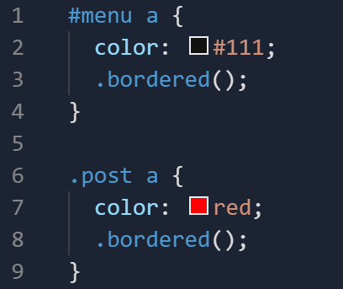
Mixins
A way to include properties from one rule-set into another rule-set
(similar to functions)
Class
“Mixing it in”

Slide 9
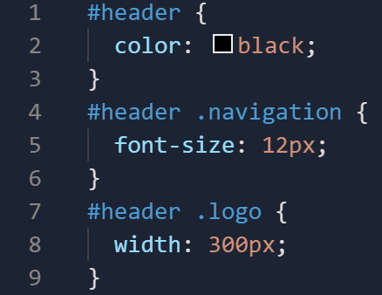
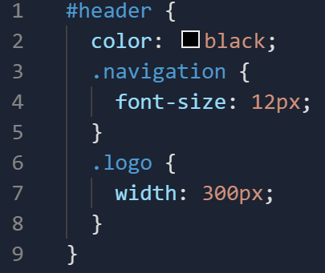
Nesting
More concise and mimics structure of HTML
@ rules can be nested in the same way as selectors
CSS
LESS

Slide 10
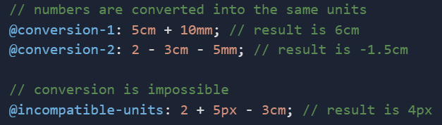
Operations
Standard +, -,*, / can operate on any number, color, or variable
If applicable, less will convert units before adding, subtracting, or comparing them
Does not convert for multiplication or division

Slide 11
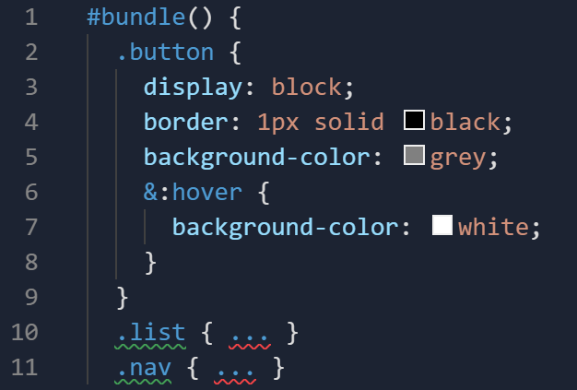
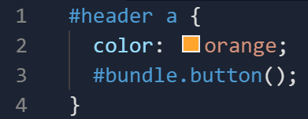
Namespaces and Accessors
Allows you to group your mixins for organization/ encapsulation
Bundle of mixins
Use

Slide 12
Functions
Less also features a plethora of functions for the user ranging from logical functions to String, List, Math, and Color functions
Color functions in Less are particularly expansive
Features include darkening and lightening, color mixing, and spinning (adjusting saturation)
You can find a detailed explanation and overview of the functions they provide: http://lesscss.org/functions/

Slide 13
Less
Advantages:
Better Structure
Optimized workflow
Features that are not available in vanilla CSS
Disadvantages:
Debugging can be harder
Compilation times can be slower
Vast CSS outputs
[Questions?]

Slide 14
DEMO

